Slide 1


Data Structures
ETCCDS202
Dr. Aarti
Faculty
School of Engineering & Technology
K.R. Mangalam University
Unit 2 : Linear Data Structures

Slide 2

Unit-2 Linear Data Structures
SESSION 11 Arrays – 1D & 2D
SESSION 12 Static & Dynamic Arrays
SESSION 13 Linked Lists Types
SESSION 14 Linked List Operations
SESSION 15 Stack ADT & Operations
SESSION 16 Stack Applications
SESSION 17 Queue ADT
SESSION 18 Queue Applications
SESSION 19 BFS using Queue
SESSION 20 Revision (Unit–2)
Notes:
New Courses replaced with New Programmes

Slide 3
Stack ADT & Operations
Session 15
Introduction to Stack
Stack Definition & LIFO Principle
Real-World Analogies of Stack
Types of Stack (Fixed & Dynamic)
Stack Representation
Basic Stack Operations
Algorithms for Stack Operations
Stack Implementation
Stack vs Array
Stack vs Linked List
Summary & Key Takeaways
Quiz / Test Yourself
References
Notes:
New Courses replaced with New Programmes

Slide 4
Recapitulation (Linked List Operations)
Traversal visits each node starting from the head until NULL
Insertion can be done at the beginning, end, or after a given node
Deletion removes nodes from the beginning, end, or after a given node
Insertion/deletion at the beginning takes O(1) time
Operations at the end generally take O(n) time due to traversal
Notes:
New Courses replaced with New Programmes

Slide 5
Quick Quiz
Traversal of a linked list always starts from the __________ node.
Insertion at the beginning of a linked list has time complexity __________.
Deletion from the end of a singly linked list requires __________ of the list.
The last node of a singly linked list points to __________.
Fastest insertion operation in a linked list
Pointer used to move to the next node
Notes:
New Courses replaced with New Programmes

Slide 6
Learning Objectives
After completing this lecture, students will be able to:
Define Stack as an Abstract Data Type (ADT)
Explain the LIFO (Last In First Out) principle
Describe stack operations: push, pop, peek, isEmpty, isFull
Implement stack using arrays and linked lists
Analyze time complexity of stack operations
Compare stack with array and linked list
Notes:
New Courses replaced with New Programmes

Slide 7
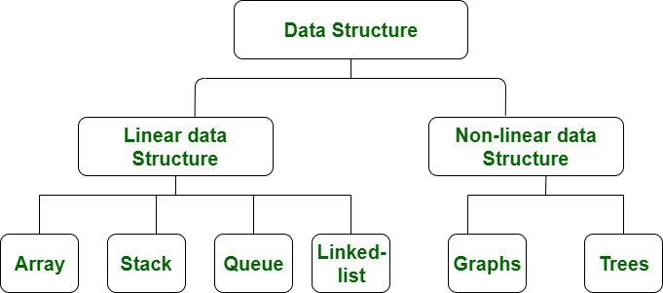
Data Structure Types
https://www.geeksforgeeks.org/data-structure-meaning/
Notes:
New Courses replaced with New Programmes

Slide 8

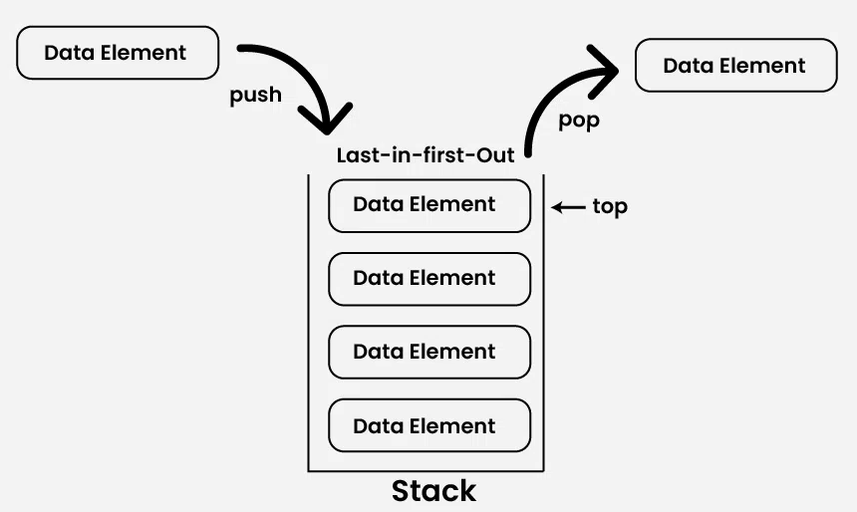
What is Stack?
A Stack is a linear data structure that holds a linear, ordered sequence of elements.
It is an abstract data type.
Follows LIFO (Last In First Out) or (FILO).
A stack is basically a container where items are inserted and removed from one end, called the top of the stack.
Limited Capacity
https://www.geeksforgeeks.org/dsa/introduction-to-stack-data-structure-and-algorithm-tutorials/
Notes:
New Courses replaced with New Programmes

Slide 9
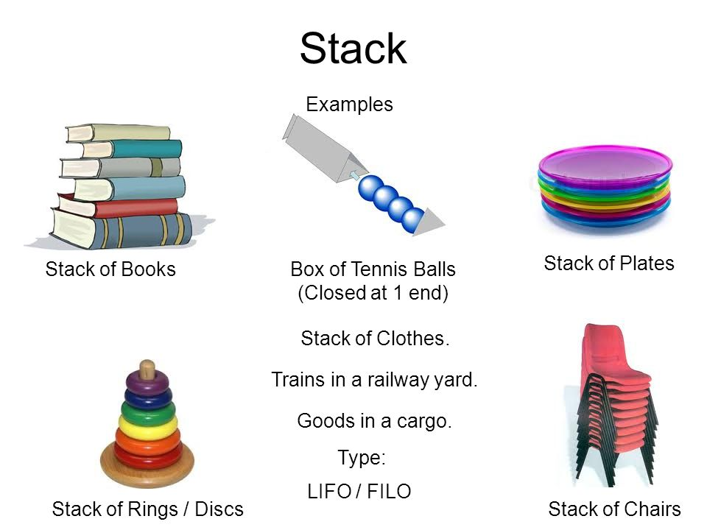
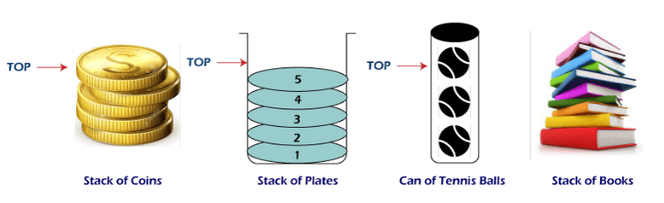
Stack Data Structure
Fig 1 : Stack Data Structure
https://www.javatpoint.com/applications-of-stack-in-data-structure
Notes:
New Courses replaced with New Programmes

Slide 10
Types of Stack
Fixed Size Stack :
Fixed size and cannot grow or shrink dynamically.
Dynamic Size Stack :
Can grow or shrink dynamically.
Dynamic stack: Automatically grows when full and shrinks when empty.
Implementation: Uses a linked list for easy resizing.
https://www.geeksforgeeks.org/dsa/introduction-to-stack-data-structure-and-algorithm-tutorials/
Notes:
New Courses replaced with New Programmes

Slide 11
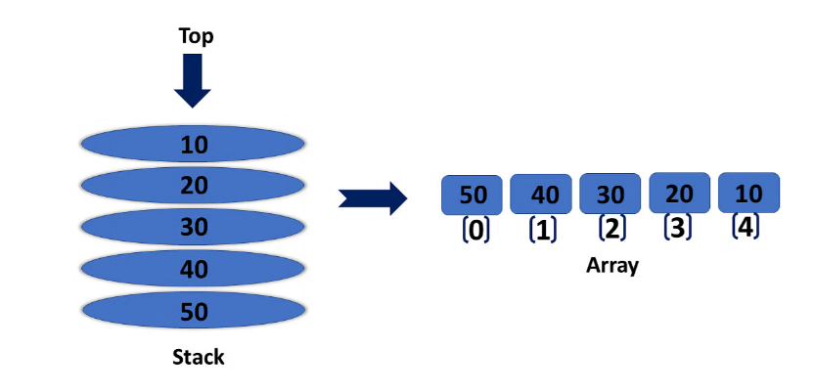
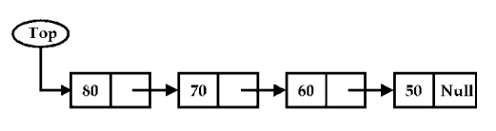
Representation of a stack
Array Representation of Stacks
Linked List Representation of Stacks
Notes:
New Courses replaced with New Programmes

Slide 12
Stack Operations
push() to insert an element into the stack
pop() to remove an element from the stack
peek() or top() returns the topmost element of the Stack without deleting it from the Stack.
Is Empty() returns true if stack is empty else false.
size() returns the size of stack.
Please Refer :
https://www.youtube.com/watch?v=HRDHgKrYHgU
Notes:
New Courses replaced with New Programmes

Slide 13
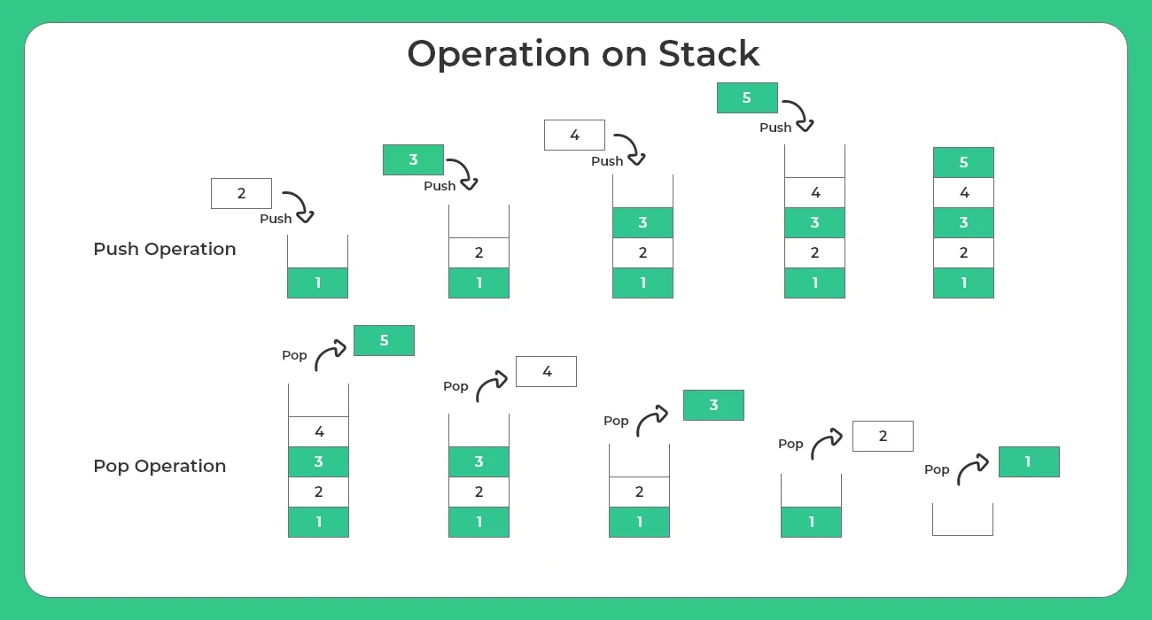
Stack Operations Push & Pop
https://prepinsta.com/data-structures/introduction-to-stacks-in-data-structures/
Notes:
New Courses replaced with New Programmes

Slide 14
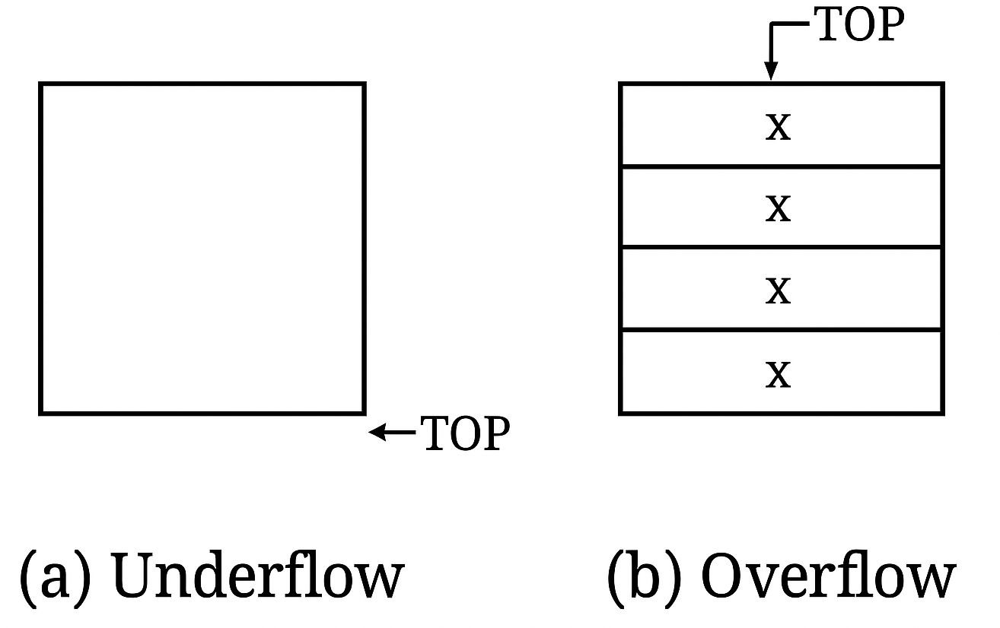
Conditions in Stack
Overflow
Underflow
https://www.geeksforgeeks.org/dsa/stack-data-structure/
Notes:
New Courses replaced with New Programmes

Slide 15
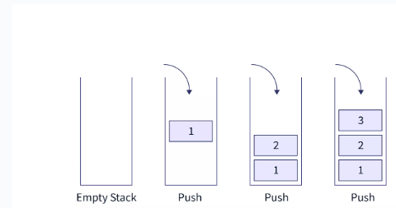
PUSH Operation
Algorithm:
Step-1: If TOP = Max-1
Print “Overflow”
Goto Step 4
Step-2: Set TOP= TOP + 1
Step-3: Set Stack[TOP]= ELEMENT
Step-4: END
Fig: Push operation
https://www.scaler.com/topics/stack-operations-in-data-structures/
Notes:
New Courses replaced with New Programmes

Slide 16
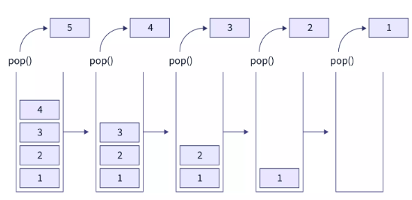
Pop Operations
Algorithm:
Step 1: START
Step 2: if top==-1
then Write “Stack is Underflow”
Step 3: otherwise
print “deleted element”
top=top-1;
Step 4: END
Notes:
New Courses replaced with New Programmes

Slide 17
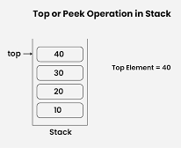
Top of Peek Operation
Algorithm:
Step-1: If TOP = NULL
PRINT “Stack is Empty”
Goto Step 3
Step-2: Return Stack[TOP]
Step-3: END
https://www.geeksforgeeks.org/dsa/introduction-to-stack-data-structure-and-algorithm-tutorials/
Notes:
New Courses replaced with New Programmes

Slide 18
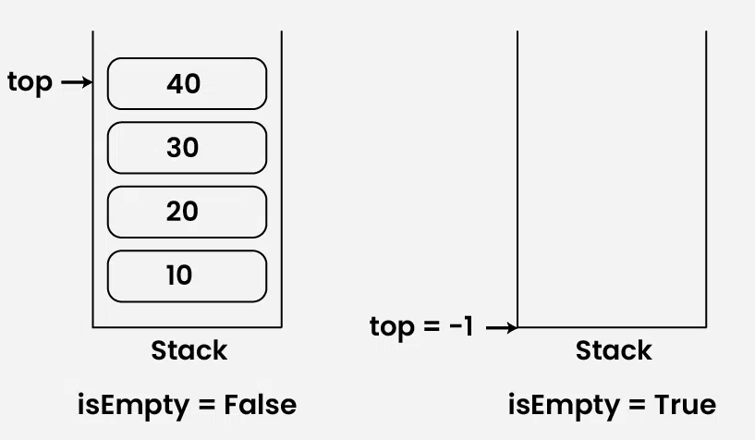
isEmpty Operation
Algorithm:
Check for the value of top in stack.
If (top == -1), then the stack is empty so return true .
Otherwise, the stack is not empty so return false .
https://www.geeksforgeeks.org/dsa/introduction-to-stack-data-structure-and-algorithm-tutorials/
Notes:
New Courses replaced with New Programmes

Slide 19
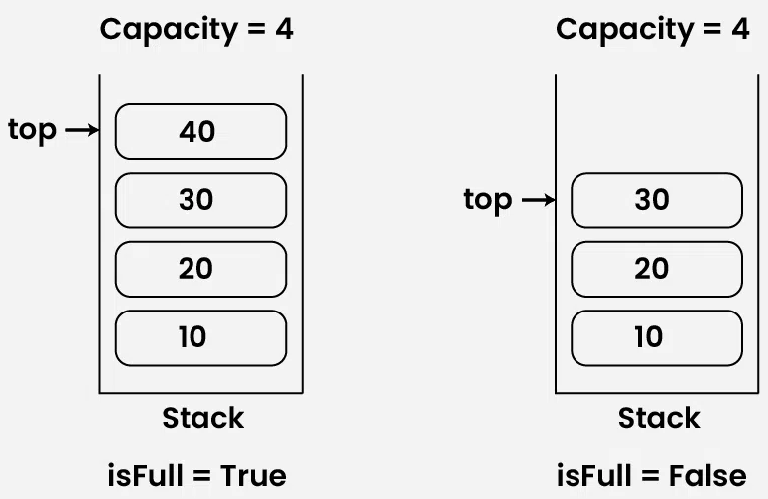
isFull Operation
Algorithm:
Check for the value of top in stack.
If (top == capacity-1), then the stack is full so return true.
Otherwise, the stack is not full so return false.
https://www.geeksforgeeks.org/dsa/introduction-to-stack-data-structure-and-algorithm-tutorials/
Notes:
New Courses replaced with New Programmes

Slide 20
Check for Understanding
❓ What happens when we push into a full stack?
❓ Which end of the stack is used for insertion?
❓ What does pop() return?
Notes:
New Courses replaced with New Programmes

Slide 21
Code for push & pop operation in Python
stack = []
# Push operation
def push(val):
stack.append(val)
print(val, "pushed into stack")
# Pop operation
def pop():
if len(stack) == 0:
print("Stack Underflow")
else:
popped = stack.pop()
print("Popped element:", popped)
# Example usage
push(10)
push(20)
push(30)
pop()
pop()
print("Final Stack:", stack)
OUTPUT:
10 pushed into stack
20 pushed into stack
30 pushed into stack
Popped element: 30
Popped element: 20
Final Stack: [10]
Notes:
New Courses replaced with New Programmes

Slide 22
Practice Question
Example:
Push 10, 20, 30 into an empty stack
Pop one element
Show:
Step-by-step stack content
TOP movement
Notes:
New Courses replaced with New Programmes

Slide 23
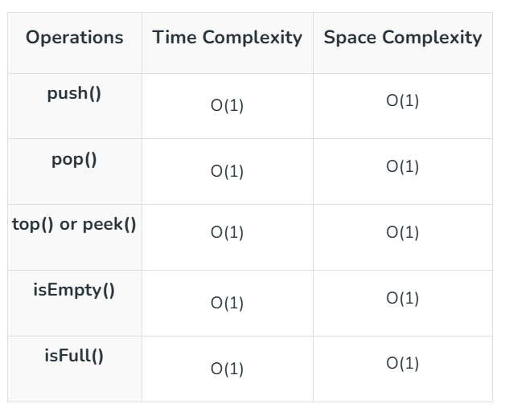
Complexity Analysis of Operations on Stack Data Structure
Notes:
New Courses replaced with New Programmes

Slide 24
Stack vs Array
Feature | Stack | Array
Nature | Abstract Data Type (ADT) | Linear data structure
Access | Restricted (LIFO – only top element) | Random access using index
Insertion/Deletion | Only at one end (TOP) | At any position
Principle | Last In First Out (LIFO) | No specific order
Operations | push, pop, peek | insert, delete, update, access
Use case | Function calls, undo/redo, expression evaluation | Storing and accessing data by index
Notes:
New Courses replaced with New Programmes

Slide 25
Stack vs Linked List
Feature | Stack | Linked List
Type | Abstract Data Type (ADT) | Linear data structure
Access | Only top element | Any node (via traversal)
Insertion/Deletion | Only at top | At beginning, end, or any position
Memory | Can be array-based or linked-list-based | Uses dynamic memory (nodes + pointers)
Order | LIFO | No fixed order
Implementation | Can use array or linked list | Uses nodes with pointers
Notes:
New Courses replaced with New Programmes

Slide 26
Quick Quiz
Which principle does Stack follow?
Which operation removes the top element?
What is stack underflow?
What is stack overflow?
Notes:
New Courses replaced with New Programmes

Slide 27
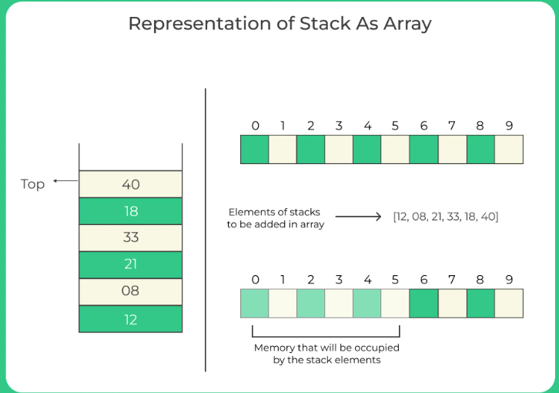
Stack Implementation
Stack can be implemented using:
Arrays
Linked List
Fig: Array Representations
https://prepinsta.com/data-structures/representation-of-a-stack/
Notes:
New Courses replaced with New Programmes

Slide 28
Limitations of Stack Implementation Using Array
Fixed Size
Wasted Space
Resizing Issues
Notes:
New Courses replaced with New Programmes

Slide 29
Stack Implementation using array in Python
# Stack implementation using array
stack = [0] * 100
n = 100
top = -1
def push(val):
global top
if top >= n - 1:
print("Stack Overflow")
else:
top += 1
stack[top] = val
def pop():
global top
if top <= -1:
print("Stack Underflow")
else:
print("The popped element is", stack[top])
top -= 1
def display():
if top >= 0:
print("Stack elements are:")
for i in range(top, -1, -1):
print(stack[i], end=" ")
print()
else:
print("Stack is empty")
Notes:
New Courses replaced with New Programmes

Slide 30
Contd.
def main():
while True:
print("\n1) Push in stack")
print("2) Pop from stack")
print("3) Display stack")
print("4) Exit")
ch = int(input("Enter choice: "))
if ch == 1:
val = int(input("Enter value to be pushed: "))
push(val)
elif ch == 2:
pop()
elif ch == 3:
display()
elif ch == 4:
print("Exit")
break
else:
print("Invalid Choice")
if __name__ == "__main__":
main()
Notes:
New Courses replaced with New Programmes

Slide 31
Test Your self
Which of the following permutation can be obtained in the same order using a stack assuming that input is the sequence 5, 6, 7, 8, 9 in that order?
7, 8, 9, 5, 6
5, 9, 6, 7, 8
7, 8, 9, 6, 5
9, 8, 7, 5, 6
Notes:
New Courses replaced with New Programmes

Slide 32
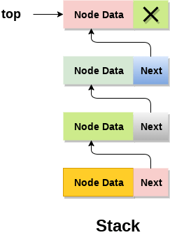
Implementation of Stack using Linked List
In the Linked List implementation of a stack, the nodes are maintained non-contiguously in memory.
Each node contains a pointer to its immediate successor node in the stack.
Stack is said to be overflown if the space left in the memory heap is not enough to create a node.
Notes:
New Courses replaced with New Programmes

Slide 33
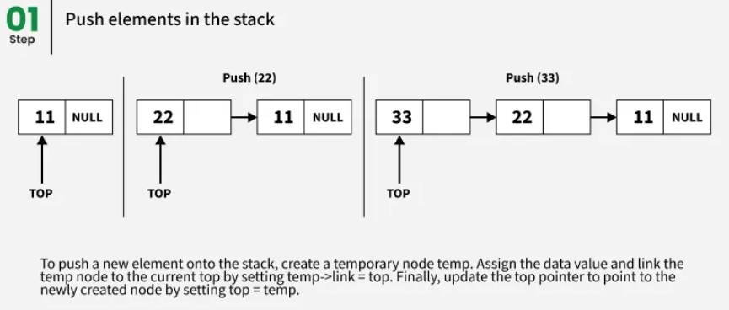
Adding a node to the stack (Push operation)
Step 1: Allocate memory for the new node and name it as NEW_NODE
Step 2: SET NEW_NODE-> DATA=VAL
Step 3: IF TOP=NULL
SET NEW_NODE->NEXT=NULL
SET TOP=NEW_NODE
ELSE
SET NEW_NODE->NEXT=TOP
SET TOP=NEW_NODE
[END OF IF]
Step 4: END
Notes:
New Courses replaced with New Programmes

Slide 34
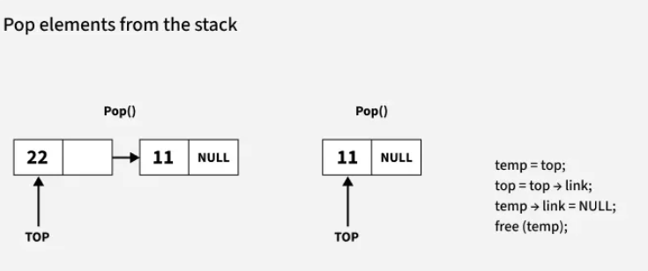
Deleting a node from the stack (POP operation)
Step 1: IF TOP=NULL
PRINT "UNDERFLOW"
Goto Step 5
[END OF IF]
Step 2: SET PTR=TOP
Step 3: SET TOP=TOP->NEXT
Step 4: FREE PTR
Step 5: END
Notes:
New Courses replaced with New Programmes

Slide 35
Key Takeaways
Stack is a linear data structure based on the LIFO principle.
All insertions and deletions happen only at the TOP.
Main operations are push, pop, peek, isEmpty, and isFull.
Stack can be implemented using arrays or linked lists.
Linked list implementation allows dynamic size but uses extra memory for pointers.
Notes:
New Courses replaced with New Programmes

Slide 36
References
Textbooks
Cormen, T. H., Leiserson, C. E., Rivest, R. L., & Stein, C., Introduction to Algorithms, MIT Press.
Lipschutz, S., Schaum’s Outline of Data Structures with C++, McGraw-Hill Education.
Reference Books
Weiss, M. A., Data Structures and Algorithm Analysis in C++, 5th Edition, Pearson Education.
Skiena, S. S., The Algorithm Design Manual, 3rd Edition, Springer.
Online Resources
GeeksforGeeks – Stack Introduction https://www.geeksforgeeks.org/stack-data-structure/
PrepInsta – Stack Operations https://prepinsta.com/data-structures/introduction-to-stacks-in-data-structures/
Scaler – Stack Operations Algorithms https://www.scaler.com/topics/stack-operations-in-data-structures/
JavaTpoint – Applications of Stack https://www.javatpoint.com/applications-of-stack-in-data-structure
Programiz – Stack in Python https://www.programiz.com/dsa/stack
Notes:
New Courses replaced with New Programmes

Slide 37
THANK YOU

